Slide 1
Terrorism
Attack-prediction
Here is where your presentation begins

Slide 2

Group Member
Mr. Sagar Sarkar Ms. Supriya I Mr. Piyush Singh
Ms. Shruti Upadhyay Mr. Siddhesh Kale Mr. Hemanshu Makwana

Slide 3
TABLE OF
01
Objectives
02
EDA
03
Visualization
04
Models & results
CONTENTS
Check For Null Values
Analyze Target Column
Analyze Feature Column
Problem statement
Attacks with respect to year
major &minor incident by countries & location
Attack type by target category
1.Logistic regression
2.Random forest
3.CATBOOST
4.Xgboost
5.KNN

Slide 4
TABLE OF
05
Deployment
06
Snapshots
CONTENTS
Deploying model on internet
Images of web-app

Slide 5

01
OBJECTIVES

Slide 6
OBJECTIVES
To understand the patterns and trends of terrorist/violent activities in certain locations over time, the methods they employ, their potential reasons in order to help law enforcement and other stakeholders prevent or mitigate future incidents.
Saturn has several rings. It's composed mostly of hydrogen and helium. It was named after a Roman god

Slide 7
INTRODUCTION
1.Analyse the Dataset and Draw inference from it.
2.Train & Evaluate ML Models to Perform Predictions

Slide 8
02
EDA

Slide 9
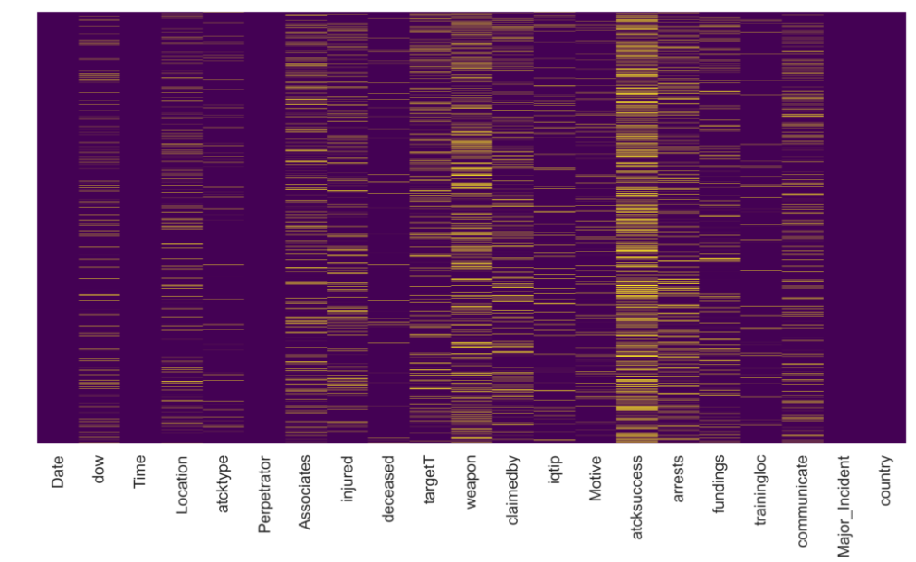
EDA
1. Check For Null Values:
We found out Null
Values in a large amount
2.Analyze target column:
Our target column has 2 possible values major or not
3.Analyze Outliers:
We found outliers in ‘Associates’ feature

Slide 10
03
Visualization

Slide 11
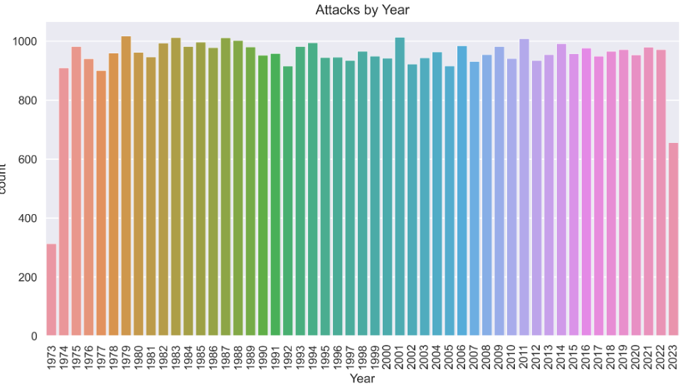
VISUALIZATION
Attacks with respect to year
Observation:
Major incident held in year 1979, 2001, 1987, 2011

Slide 12
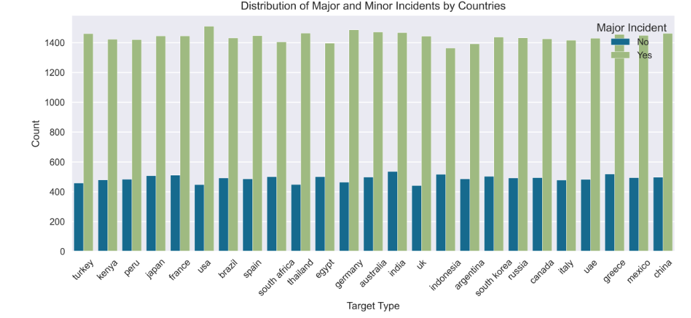
VISUALIZATION
Attacks with respect to Countries
Observation:
Major attacked Countries: USA, Germany, Greece, Mexico, China

Slide 13
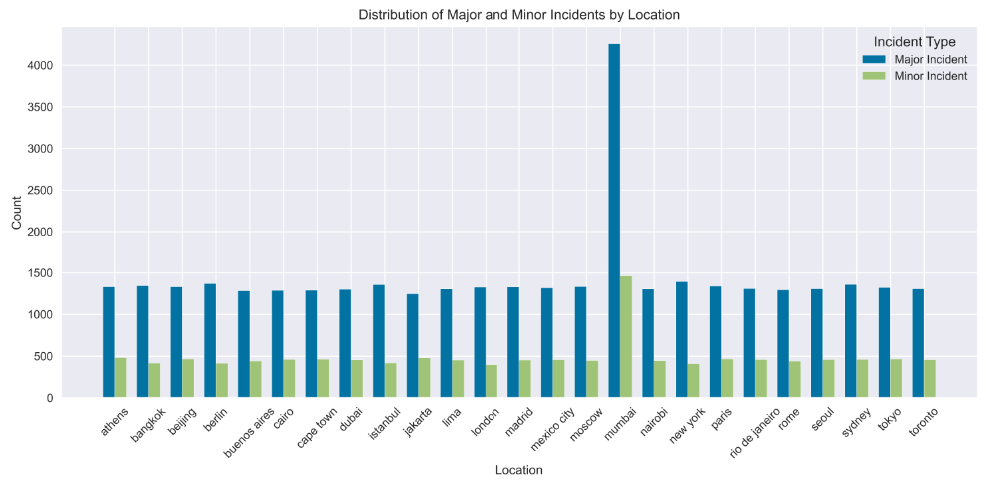
VISUALIZATION
Attacks with respect to Location
Observation:
Observation:
1) Majority of major attack took place at Location: mumbai
2) Majority of minor attack took place at Location: mumbai

Slide 14
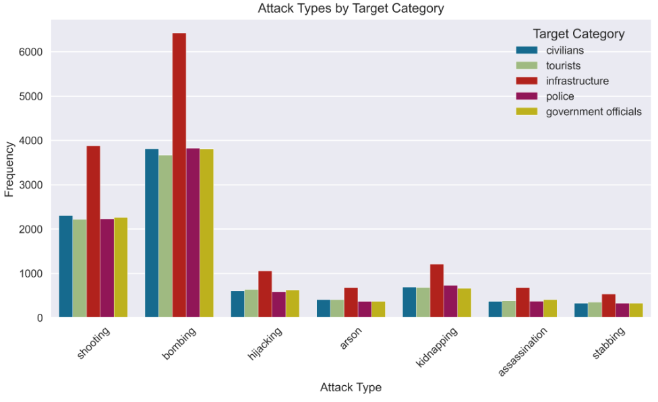
VISUALIZATION
Attack type with respect to Target category
Observation:
Observation:
1) Majority of attacks are bombing
2) Mostly bombing are done on infrastructure

Slide 15
04
Model &result

Slide 16
Models
We had use ML Packages like Scikit-learn, Catboost to build Machine Learning Classification Models.
Models that we used are Logistic Regressor ,Random Forest , CatBoostClassifier , XGBoost ,Kneighbour Classifier.
We build and tested every mentioned models and found that the catboost Classifier was providing us with best accuracy

Slide 17
Evaluation results
Results :
Models | Accuracy
Logistic Regression | 99.61
Random forest | 99.77
CATBOOST | 99.78
Xgboost | 99.78
KNN | 99.30

Slide 18
05
Deployment

Slide 19
Deployment
For the Deployment we used Streamlit which provides us with simple easy to write script to create minimal web-page.
We have used spyder which is an open-source cross-platform integrated development environment for scientific programming in the Python language.

Slide 20
06
Snapshots

Slide 21

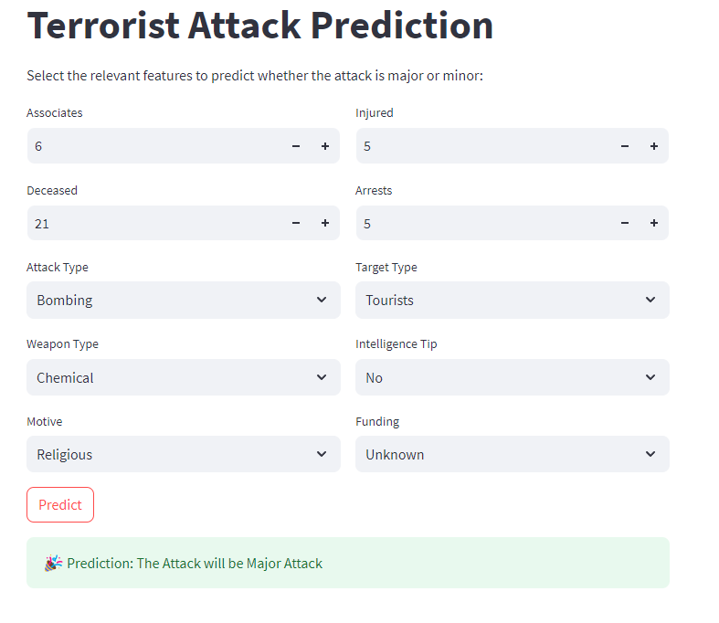
Deployment snapshot

Slide 22
MANY
THANKS!
Please keep this slide as attribution

